Slide 1
Unit I: Water Technology Topic: Electrodialysis
Dr. P. G. Umape
Assistant Professor
Pune Institute of Computer Technology

Slide 2
Questions
Explain why electrodialysis is efficient way for desalination of water?
Give the methods used for desalination of water.

Slide 3
Electrodialysis
Learning outcomes
Students should have knowledge of principle of electrodialysis.
Student should describe the construction and working of electrodialysis unit.
Student should know the applications and limitations of electrodialysis process.

Slide 4
Electrodialysis
Content:
Principle (1 min)
Construction and working (5 min)
Applications and limitations (1 min)

Slide 5
Electrodialysis
Principle:
It is a process of separating ionic impurities from water with help of ion selective membrane, under the influence of electric current.
Construction and working:
The electrodialysis unit consist of a tank
The tank is provided with number of pairs of ion selective membrane

Slide 6
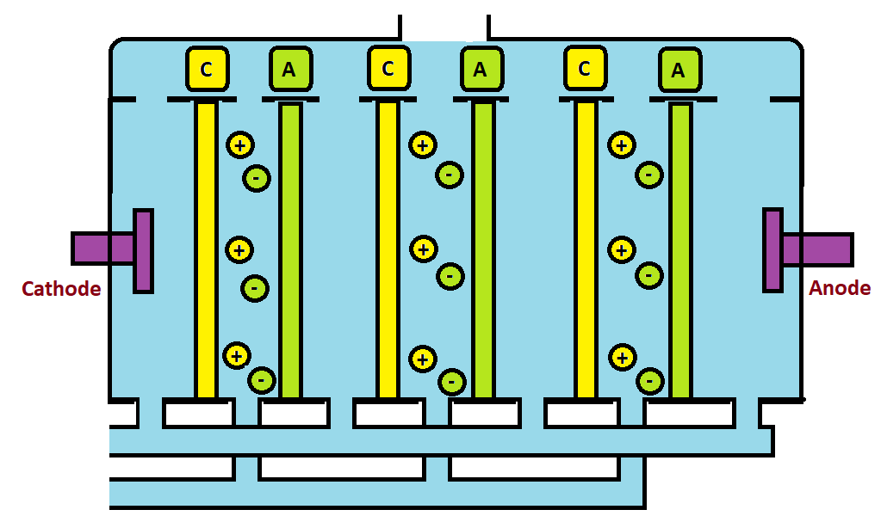
Electrodialysis
Hard water or Saline water
Concentrated water
Pure water
C- Cation selective membrane
A- Anion selective membrane

Slide 7
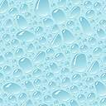
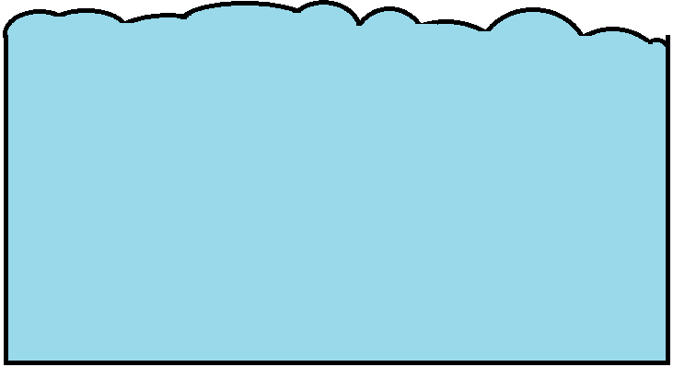
Electrodialysis
Hard water or Saline water
A
C
A
C
+
+
-
-
+
+
Cathode
-
Anode
-
+
+
-
-

Slide 8
Electrodialysis
Hard water or Saline water
Concentrated water
Pure water
C- Cation selective membrane
A- Anion selective membrane

Slide 9
Electrodialysis
Construction and working:
The ion selective membrane are equipped with charged species
Cation selective membranes are fixed with negatively charged species, these membrane allows only cation to pass through and repel anion
Anion selective membranes are fixed with positively charged species, these membrane allows only anion to pass through and repel cation

Slide 10
Electrodialysis
Construction and working:
The instrument is also provided with anode and cathode to apply electric field.
Hard water or saline water is filled in the dialysis unit.
Electrical field is applied, perpendicular to the direction of flow of water.
The cation start migrating towards cathode and anion towards anode

Slide 11
Electrodialysis
Construction and working:
While migrating towards the respective pole, the cation will be allowed to pass the cation exchange membrane but anions will be repelled.
While anion will be passed through anion exchange membrane but cations will be repelled.
When cation and anion enters in the neighbouring compartment, they will be restricted in the same neighbouring compartment due to membrane of opposite ion permeability
Hence alternate streams of concentrated and pure water is obtained, which are separately removed form the unit.

Slide 12
Electrodialysis
Applications:
Saline water can be efficiently converted to water of portable quality by this method.
It can be used to remove ionic impurities from the industrial waste water.
By removing limited amount of salt from water, sea water can be converted to drinkable water.

Slide 13
Electrodialysis
Limitations:
50 % of water is wasted or needs recycling.
The ion exchange membrane requires frequent replacement.
Initial investment is high
Non-ionic impurities can not be removed

Slide 14
Summary
Principle of electrodialysis
Instrumentation
Working of ion exchange membrane
Electrodialysis process
Applications
Disadvantages

Slide 15
Thank You
Thank You

